Slide 1

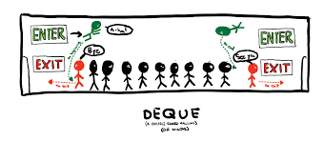

21CSC201J_Data Structures And Algorithms

Slide 2

QUEUES
A queue is a data structure that models/enforces the first-come first-serve order, or equivalently the first-in first-out (FIFO) order.
A waiting line is a good real-life example of a queue. (In fact, the British word for “line” is “queue”.)

Slide 3
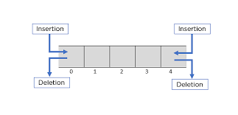
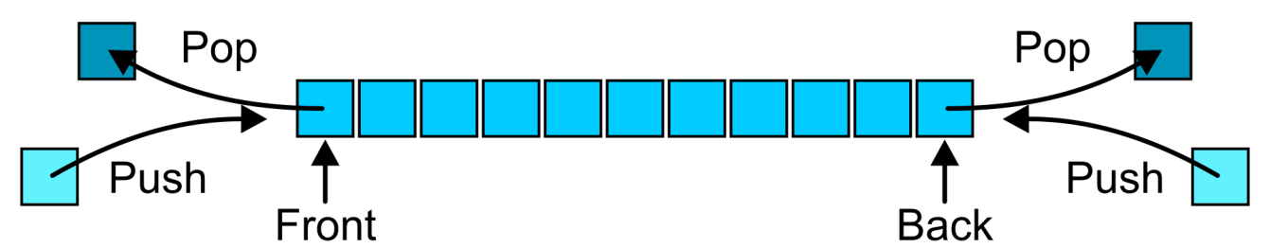
DEQUES (Double Ended Queue)
Elements can be added or removed at either ends.
It is a generalized version of the linear queue in which both the insertion and deletion can be performed at both the ends.

Slide 4
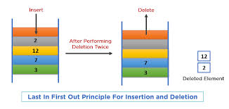
Properties of Deque
A Deque can perform both the Insertion and Deletion based on the Last in First Out (LIFO) principle.

Slide 5
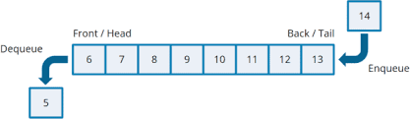
Properties of Deque
A Deque can also perform the Insertion and Deletion based on First in First Out (FIFO) principle.

Slide 6
Types of Deque
Input restricted Deque
Output restricted Deque

Slide 7
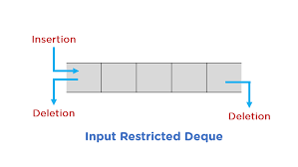
Input restricted Deque
Input restricted Deque
It is Deque that has certain restrictions for inserting an element.
Elements can be inserted from one end.
Elements can be removed at both the ends.

Slide 8
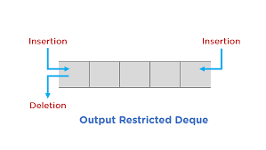
Output restricted Deque
Output restricted Deque
It is Deque that has certain restrictions for removing an element from deque.
Elements can be removed from one end.
Elements can be inserted at both the ends.

Slide 9
Operations in Deque
The basic operations that can be performed on Deque are
1. Insertion at front
2. Insertion at rear
3. Deletion at front
4. Deletion at rear

Slide 10
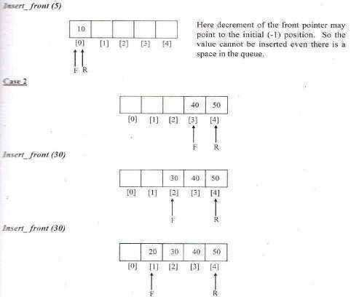
Insertion at Front

Slide 11
Routine to insert an element at Front end
void Insert_Front ( int X, DEQUE DQ )
{
if( Front = = 0 )
Error(“Element present in Front!!!!! Insertion not possible”);
else if(Front = = -1)
{
Front = Front + 1;
Rear = Rear + 1;
DQ[Front] = X;
}
else
{
Front = Front - 1;
DQ[Front] = X;
}
}

Slide 12
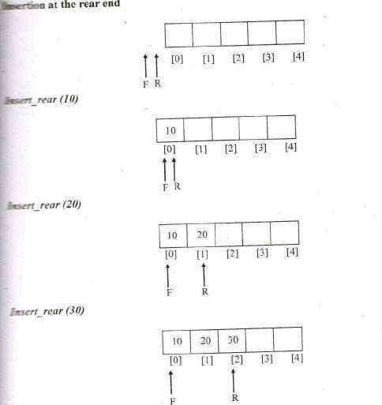
Insertion at Rear

Slide 13
Routine to insert an element at Rear end
void Insert_Rear (int X, DEQUE DQ)
{
if( Rear = = Arraysize - 1)
Error(“Full Queue!!!! Insertion not possible”);
else if( Rear = = -1)
{
Front = Front + 1;
Rear = Rear + 1;
DQ[ Rear ] = X;
}
else
{
Rear = Rear + 1;
DQ[ Rear ] = X;
}
}

Slide 14
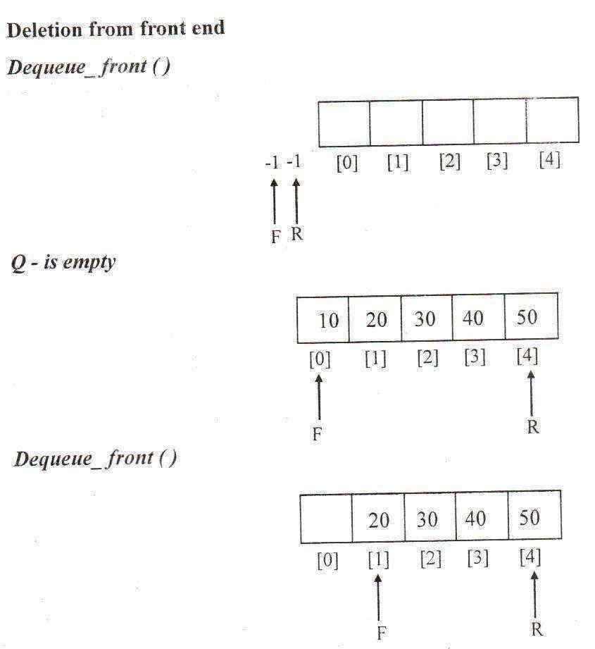
Delete at front

Slide 15
Routine to delete an element from Front end
void Delete_Front(DEQUE DQ)
{
if(Front = = - 1)
Error(“Empty queue!!!! Deletion not possible”);
else if( Front = = Rear )
{
X = DQ[ Front];
Front = - 1;
Rear = - 1;
}
else
{
X = DQ [ Front ];
Front = Front + 1;
}
}

Slide 16
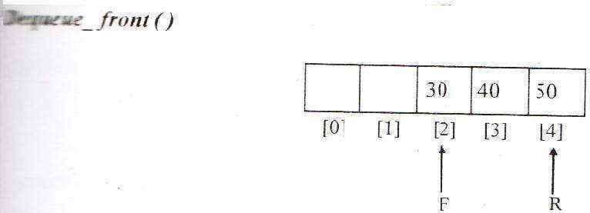
Delete at rear

Slide 17
Routine to delete an element from Rear end
void Delete_Rear(DEQUE DQ)
{
if( Rear = = - 1)
Error(“Empty queue!!!! Deletion not possible”);
else if( Front = = Rear )
{
X = DQ[ Rear ];
Front = - 1;
Rear = - 1;
}
else
{
X = DQ[ Rear ];
Rear = Rear - 1;
}
}

Slide 18
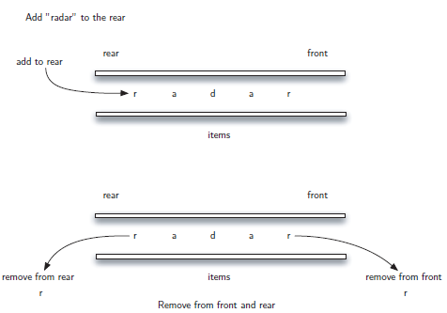
APPLICATIONS OF DEQUE
Palindrome-checker

Slide 19
APPLICATIONS OF DEQUE
A-Steal job scheduling algorithm
The A-Steal algorithm implements task scheduling for several processors(multiprocessor scheduling).
The processor gets the ﬁrst element from the deque.
When one of the processor completes execution of its own threads it can steal a thread from another processor.
It gets the last element from the deque of another processor and executes it.

Slide 20
OTHER APPLICATIONS OF DEQUE
Undo-Redo operations in Software applications.
Storing a web browser's history. Recently visited URLs are added to the front of the deque, and the URL at the back of the deque is removed after some specified number of insertions at the front.

Slide 21


